Slide 1

“Hola. I’m Bob. I’m the new marketing intern and everyone is talking about ADEL.”

Slide 2
What’s ADEL?

Slide 3
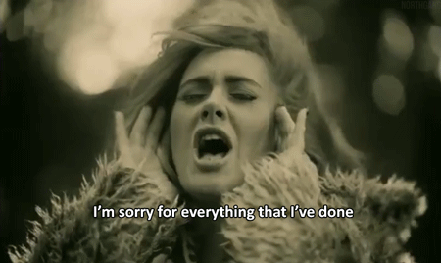

Slide 4
ADaptive
Event
Logic

Slide 5
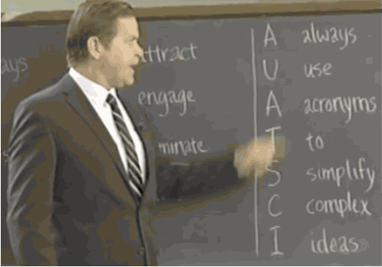

Slide 6
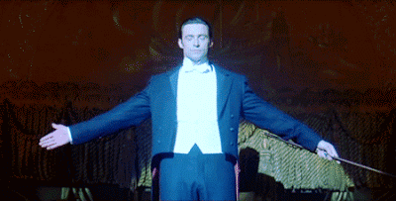

Slide 7

Hola. I’m Acronymous.

Slide 8

DEMO

Slide 9

#13
Acronymous

